Slide 1
Introduction to BeehiveZ
JinTao
2009.9.19

Slide 2
Outline
Overview
Why
What
How (the state of the art)
Future work

Slide 3
Overview
Sub project of USDMS
  Unstructed data management system
    Top level project
    Three teams on different sub projects
Name
  Bee
    diligent, collaborative
  Beehive
    Behave
  Z
    zero

Slide 4

Logo

Slide 5
History
  V1.0
    2009-7-13 :2009-9-1
      Design, coding …
      He Tengfei, Wu Nianhua, Li Tao, Jin Tao
    C/S architecture
    Plugin framework
  V2.0
    2009-9-1:2009-9-13
    Refined
    One user, single process

Slide 6
Outline
Overview
Why
What
How (the state of the art)
Future work

Slide 7
Why
Too many process models
  Invaluable asset
  Core data of enterprises
How to manage them?
  Store
  Query for reuse, check
  Discover knowledge from them
Help in enterprise management

Slide 8
Outline
Overview
Why
What
How (the state of the art)
Future work

Slide 9
what
Store
Query
Mining & learning
Look process model as a special type of data

Slide 10
Goal
  Model query
    Wizard for business process model
  Frequent pattern mining
    In a enterprise
    In a industry (vocation)
  Cluster
  Classify
  compliance audit
  ……

Slide 11
Outline
Overview
Why
What
How (the state of the art)
Future work

Slide 12
How
Store the model definition in a relational database management system (derby)
Index on Petri net
Query through index
  Improve query efficiency

Slide 13
demo

Slide 14
Four cornerstone in V2.0
  Singleton pattern
  Observer pattern
  AOP (aspect oriented programming)
  Registerable index algorithm
Model data source
  Crawl from internet
  Automatic generated
  From TiPLM (or enterprise directly)

Slide 15
details
Crawler
GWF generator
Simple path index
Inverted index
Semantic query
For researcher

Slide 16
Crawler
  Google search
    Use url just like in IE use the “filetype:”
      SOAP api denied
      Ajax api limited
  Html parser
  Download the file

Slide 17
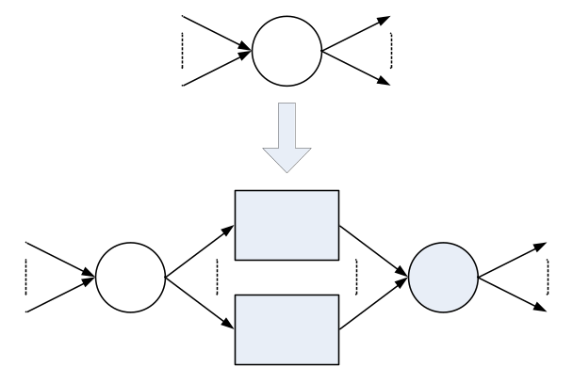
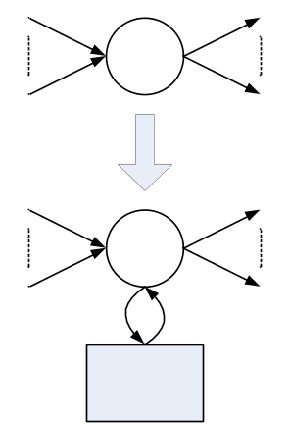
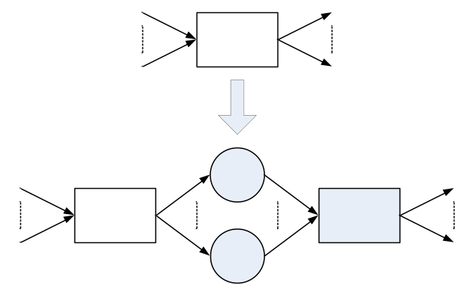
GWF generator

Slide 18
Simple path index
  Pre->suc
    String
  Hash
    String to long
  B+ tree
    Random long to ordinal long
  Inverted table
    Ordinal long to model list

Slide 19
Inverted index
  Transition name to model list

Slide 20
Semantic query
  Use wordnet to compute the similarity of two phrases

Slide 21
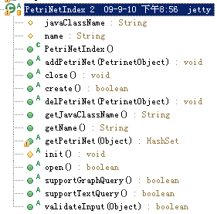
For researcher
  Extends PetriNetIndex
  Register

Slide 22
Outline
Overview
Why
What
How (the state of the art)
Future work

Slide 23
Future work
Index algorithm
  Graph index
  Graph match

Slide 24
Q&A

